Slide 1

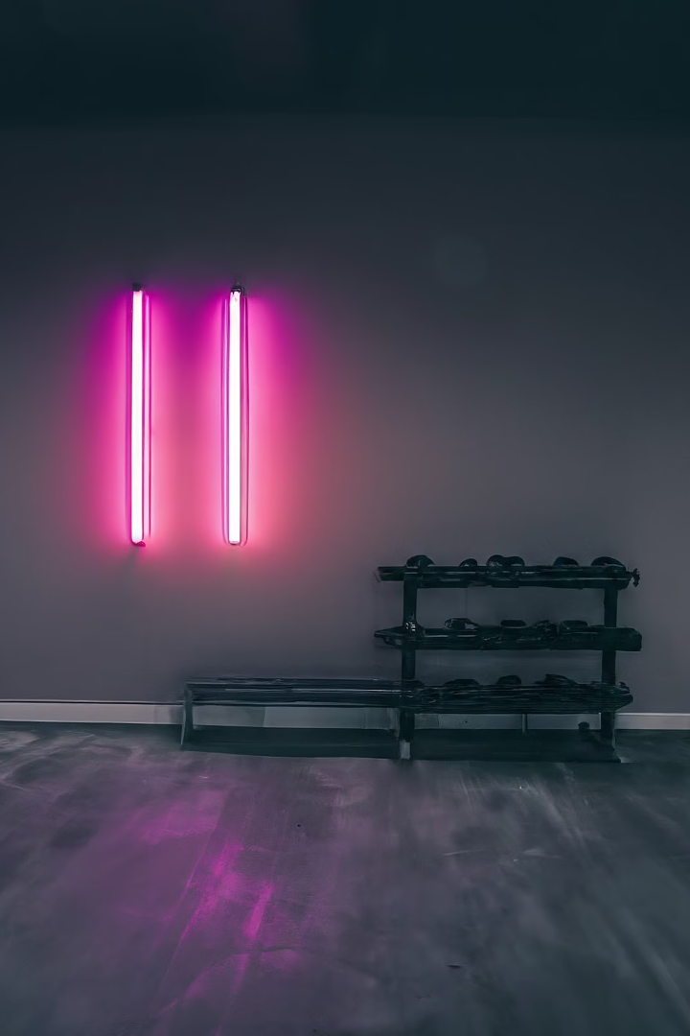
Welcome to FitVerse
Unlock your full potential with FitVerse - your one-stop destination for all your fitness needs. Dive into a world of personalized workouts, smart tracking, and a vibrant community to help you achieve your health goals.
by rcht Jain

Slide 2
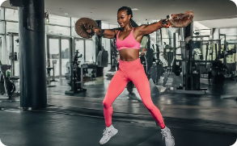
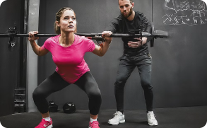
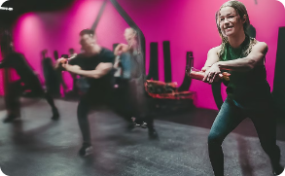
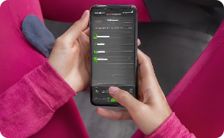
Explore Our Workouts
Comprehensive Workout Library
Expert Guidance
Collaborative Community
Personalized Tracking
Get personalized coaching and advice from our team of experienced trainers to ensure you achieve your fitness objectives safely and effectively.
Discover a vast collection of workout routines and exercise videos tailored to different fitness levels, goals, and preferences.
Join our community of fitness enthusiasts and share your progress, challenges, and triumphs while motivating each other to reach new heights.
Utilize our cutting-edge fitness tracking tools to monitor your progress, set goals, and receive tailored workout recommendations to keep you motivated.

Slide 3
Fitness Calculator
1
Body Metrics
2
Basal Metabolic Rate
Enter your height, weight, age, and gender to get personalized fitness metrics.
Estimate your daily calorie needs based on your BMR and activity level.
3
Calorie Tracker
4
Goal Setting
Log your daily food intake and exercise to track your calorie balance.
Set weight loss or muscle gain goals and get tailored workout and nutrition plans.

Slide 4

Metabolic Rate Estimator
Discover your unique metabolic rate with our advanced calculator. Input your age, gender, height, and weight, and get a personalized estimate of your basal metabolic rate (BMR) - the energy your body burns at rest.
Use this crucial data to optimize your diet and exercise routine for sustainable weight management and improved overall fitness.

Slide 5
Daily Calorie Needs
2K
3.5K
Calories
Active Calories
The average person needs around 2,000 calories per day to maintain their weight.
Active individuals may need up to 3,500 calories per day to fuel their workouts and daily activity.
Knowing your daily calorie needs is essential for managing your weight and fueling your fitness goals. Our calorie calculator can help you determine your unique calorie requirements based on your age, activity level, and other factors.

Slide 6

Track Your Progress
1
Personalized Dashboard
Monitor your fitness goals, workout history, and progress metrics in one easy-to-use dashboard. Visualize your journey at a glance.
2
Progress Tracking
Log your workouts, measurements, and other key data to track your improvements over time. Celebrate your milestones and identify areas for growth.
3
Insightful Analytics
Analyze your data to gain deeper insights into your fitness levels, calories burned, and training effectiveness. Optimize your regimen for maximum results.

Slide 7
Plan Your Fitness Schedule
Set Realistic Goals
Block Time for Workouts
Mix it Up
Schedule Recovery
Incorporate a variety of exercises into your weekly schedule, such as strength training, cardio, and flexibility work. This will help you stay motivated and prevent plateaus.
Determine your fitness objectives, whether it's losing weight, building muscle, or improving endurance. Make sure your goals are specific, measurable, and achievable within your schedule.
Prioritize your fitness routine by blocking off time in your calendar. Treat your workouts like important appointments that can't be rescheduled.
Don't forget to plan for rest and recovery days. Your body needs time to repair and rebuild, so make sure to include active recovery activities as well.

Slide 8





Achieve Your Goals
Visualize
1
Clearly define your fitness goals and imagine achieving them.
Plan
2
Create a structured plan with milestones and actionable steps.
3
Execute
Consistently follow your plan and track your progress.
Adjust
4
Regularly evaluate and refine your approach based on your results.
Celebrate
5
Acknowledge your achievements and stay motivated for your next goal.
Reaching your fitness goals requires a holistic approach. Start by clearly visualizing what you want to accomplish, then plan out the steps to get there. Consistently execute your plan, tracking your progress along the way. Be prepared to adjust your approach as needed, and don't forget to celebrate your victories - they will fuel your drive for the next challenge.

Slide 9

Community and Support
Community
Expert Guidance
Discussion Forums
Celebrate Milestones
Connect with like-minded individuals on your fitness journey. Share tips, motivate each other, and build a supportive network.
Benefit from the expertise of our team of certified trainers and nutritionists. Get personalized advice to help you reach your goals.
Engage in discussions, ask questions, and learn from the experiences of others in our vibrant online community forums.
Share your progress and celebrate your achievements with the FitVerse community. Inspire others and stay motivated.

Slide 10
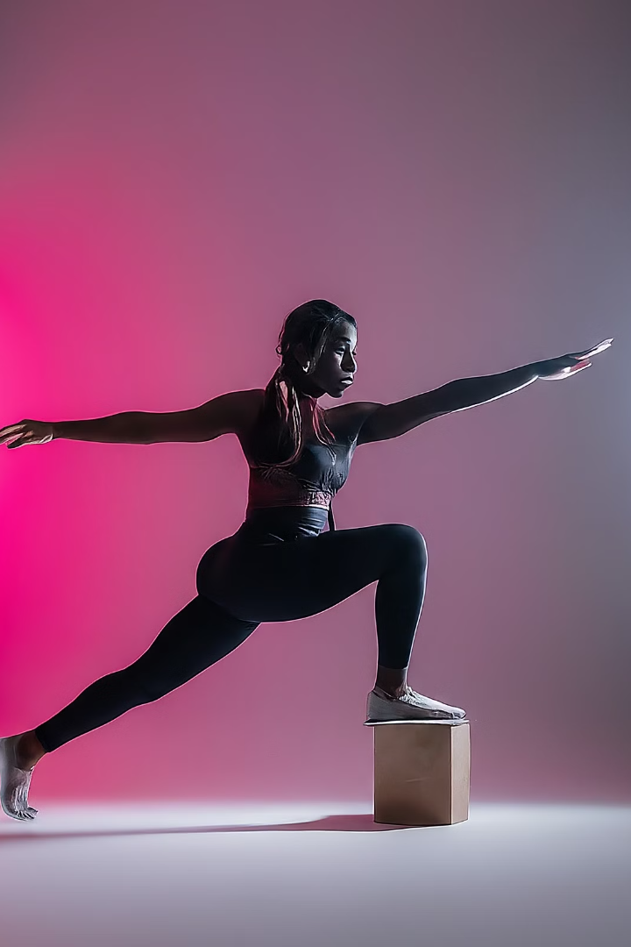
Start Your Fitness Journey
Take the first step towards a healthier, fitter you with FitVerse.
Get started with our easy-to-follow workout plans, fitness calculators, and progress tracking tools.
Build a customized fitness routine that fits your lifestyle and goals.

